Slide 1



Software Engineering
WEEK 3
ENGR. Muhammad UMER HAROON

Slide 2

WEEK 3

Slide 3
Coping with change

Slide 4
Coping with change
Change is inevitable in all large software projects.
Business changes lead to new and changed system requirements
New technologies open up new possibilities for improving implementations
Changing platforms require application changes
Change leads to rework so the costs of change include both rework (e.g. re-analysing requirements) as well as the costs of implementing new functionality

Slide 5
Reducing the costs of rework
Change anticipation, where the software process includes activities that can anticipate possible changes before significant rework is required.
For example, a prototype system may be developed to show some key features of the system to customers.
Change tolerance, where the process is designed so that changes can be accommodated at relatively low cost.
This normally involves some form of incremental development. Proposed changes may be implemented in increments that have not yet been developed. If this is impossible, then only a single increment (a small part of the system) may have be altered to incorporate the change.

Slide 6
Coping with changing requirements
System prototyping, where a version of the system or part of the system is developed quickly to check the customer’s requirements and the feasibility of design decisions. This approach supports change anticipation.
Incremental delivery, where system increments are delivered to the customer for comment and experimentation. This supports both change avoidance and change tolerance.

Slide 7
Software prototyping
A prototype is an initial version of a system used to demonstrate concepts and try out design options.
A prototype can be used in:
The requirements engineering process to help with requirements elicitation and validation;
In design processes to explore options and develop a UI design;
In the testing process to run back-to-back tests.

Slide 8
Benefits of prototyping
Improved system usability.
A closer match to users’ real needs.
Improved design quality.
Improved maintainability.
Reduced development effort.

Slide 9
The process of prototype development

Slide 10
Prototype development
May be based on rapid prototyping languages or tools
May involve leaving out functionality
Prototype should focus on areas of the product that are not well-understood;
Error checking and recovery may not be included in the prototype;
Focus on functional rather than non-functional requirements such as reliability and security

Slide 11
Throw-away prototypes
Prototypes should be discarded after development as they are not a good basis for a production system:
It may be impossible to tune the system to meet non-functional requirements;
Prototypes are normally undocumented;
The prototype structure is usually degraded through rapid change;
The prototype probably will not meet normal organisational quality standards.

Slide 12
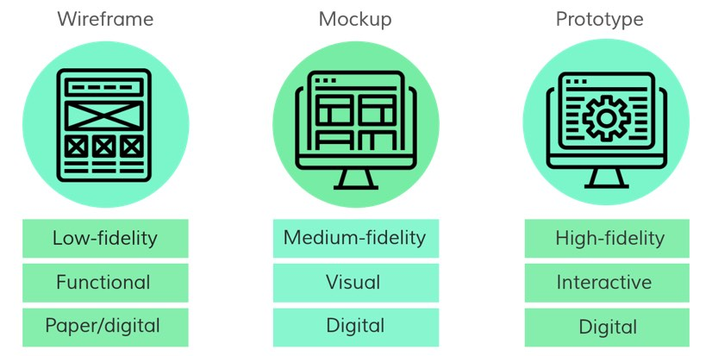

Slide 13
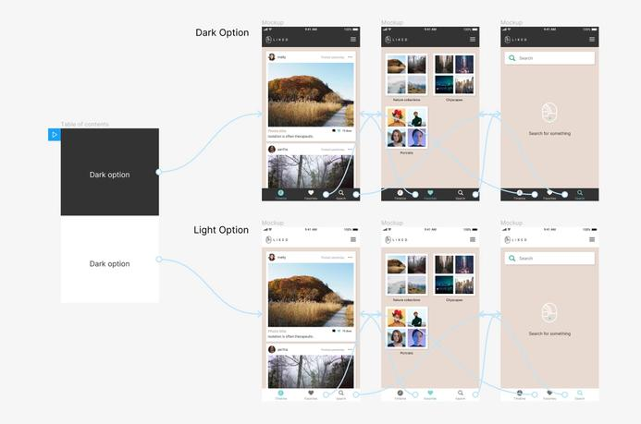

Slide 14
Agile Development

Slide 15
Agile development
Program specification, design and implementation are inter-leaved
The system is developed as a series of versions or increments with stakeholders involved in version specification and evaluation
Frequent delivery of new versions for evaluation
Extensive tool support (e.g. automated testing tools) used to support development.
Minimal documentation – focus on working code

Slide 16
Plan-driven and agile development
Plan-driven development
A plan-driven approach to software engineering is based around separate development stages with the outputs to be produced at each of these stages planned in advance.
Not necessarily waterfall model – plan-driven, incremental development is possible
Agile development
Specification, design, implementation and testing are inter-leaved and the outputs from the development process are decided through a process of negotiation during the software development process.

Slide 17
Agile methods

Slide 18
Agile methods
Dissatisfaction with the overheads involved in software design methods of the 1980s and 1990s led to the creation of agile methods. These methods:
Focus on the code rather than the design
Are based on an iterative approach to software development
Are intended to deliver working software quickly and evolve this quickly to meet changing requirements.
The aim of agile methods is to reduce overheads in the software process (e.g. by limiting documentation) and to be able to respond quickly to changing requirements without excessive rework.

Slide 19
Agile manifesto
The Agile Manifesto states that the Agile method is about improving
software development by doing it and sharing that knowledge with others.
We are uncovering better ways of developing software by doing it and helping others do it. Through this work we have come to value:
Individuals and interactions over processes and tools Working software over comprehensive documentation Customer collaboration over contract negotiation Responding to change over following a plan
That is, while there is value in the items on the right, we value the items on the left more.

Slide 20
The principles of agile methods
Principle | Description
Customer involvement | Customers should be closely involved throughout the development process. Their role is provide and prioritize new system requirements and to evaluate the iterations of the system.
Incremental delivery | The software is developed in increments with the customer specifying the requirements to be included in each increment.
People not process | The skills of the development team should be recognized and exploited. Team members should be left to develop their own ways of working without prescriptive processes.
Embrace change | Expect the system requirements to change and so design the system to accommodate these changes.
Maintain simplicity | Focus on simplicity in both the software being developed and in the development process. Wherever possible, actively work to eliminate complexity from the system.
The development team's abilities should be acknowledged and utilized. Team members should be free to find their own methods of working without strict processes.

Slide 21
Agile method applicability
Product development where a software company is developing a small or medium-sized product for sale.
Virtually all software products and apps are now developed using an agile approach
Custom system development within an organization, where there is a clear commitment from the customer to become involved in the development process and where there are few external rules and regulations that affect the software.

Slide 22
Agile development techniques

Slide 23
Extreme programming
A very influential agile method, developed in the late 1990s, that introduced a range of agile development techniques.
Extreme Programming (XP) takes an ‘extreme’ approach to iterative development.
New versions may be built several times per day;
Increments are delivered to customers every 2 weeks;
All tests must be run for every build and the build is only accepted if tests run successfully.
The ideal team size in Extreme Programming (XP) is small,
typically between 2 to 10 people.

Slide 24
The extreme programming release cycle

Slide 25
Extreme programming practices (a)
Principle or practice | Description
Incremental planning | Requirements are recorded on story cards and the stories to be included in a release are determined by the time available and their relative priority. The developers break these stories into development ‘Tasks’.
Small releases | The minimal useful set of functionality that provides business value is developed first. Releases of the system are frequent and incrementally add functionality to the first release.
Simple design | Enough design is carried out to meet the current requirements and no more.
Test-first development | An automated unit test framework is used to write tests for a new piece of functionality before that functionality itself is implemented.
Refactoring | All developers are expected to refactor the code continuously as soon as possible code improvements are found. This keeps the code simple and maintainable.

Slide 26
Extreme programming practices (b)
Pair programming | Developers work in pairs, checking each other’s work and providing the support to always do a good job.
Collective ownership | The pairs of developers work on all areas of the system, so that no islands of expertise develop and all the developers take responsibility for all of the code. Anyone can change anything.
Continuous integration | As soon as the work on a task is complete, it is integrated into the whole system. After any such integration, all the unit tests in the system must pass.
Sustainable pace | Large amounts of overtime are not considered acceptable as the net effect is often to reduce code quality and medium term productivity
On-site customer | A representative of the end-user of the system (the customer) should be available full time for the use of the XP team. In an extreme programming process, the customer is a member of the development team and is responsible for bringing system requirements to the team for implementation.
Developers work in pairs to cover all aspects of the system,
avoiding specialized areas and ensuring all developers are responsible for all the code.

Slide 27
XP and agile principles
Incremental development is supported through small, frequent system releases.
Customer involvement means full-time customer engagement with the team.
People not process through pair programming, collective ownership and a process that avoids long working hours.
Change supported through regular system releases.
Maintaining simplicity through constant refactoring of code.

Slide 28
Influential XP practices
Extreme programming has a technical focus and is not easy to integrate with management practice in most organizations.
Consequently, while agile development uses practices from XP, the method as originally defined is not widely used.
Key practices
User stories for specification
Refactoring
Test-first development
Pair programming
So, even though Agile development incorporates practices from XP,
the original XP method is not commonly used.

Slide 29
User stories for requirements
In XP, a customer or user is part of the XP team and is responsible for making decisions on requirements.
User requirements are expressed as user stories or scenarios.
These are written on cards and the development team break them down into implementation tasks. These tasks are the basis of schedule and cost estimates.
The customer chooses the stories for inclusion in the next release based on their priorities and the schedule estimates.

Slide 30
A ‘prescribing medication’ story

Slide 31
Examples of task cards for prescribing medication

Slide 32
Refactoring
Conventional wisdom in software engineering is to design for change. It is worth spending time and effort anticipating changes as this reduces costs later in the life cycle.
XP, however, maintains that this is not worthwhile as changes cannot be reliably anticipated.
Rather, it proposes constant code improvement (refactoring) to make changes easier when they have to be implemented.

Slide 33
Refactoring
Programming team look for possible software improvements and make these improvements even where there is no immediate need for them.
This improves the understandability of the software and so reduces the need for documentation.
Changes are easier to make because the code is well-structured and clear.
However, some changes requires architecture refactoring and this is much more expensive.

Slide 34
Examples of refactoring
Re-organization of a class hierarchy to remove duplicate code.
Tidying up and renaming attributes and methods to make them easier to understand.
The replacement of inline code with calls to methods that have been included in a program library.

Slide 35
BREAK

Slide 36
Test-first development
Testing is central to XP and XP has developed an approach where the program is tested after every change has been made.
XP testing features:
Test-first development.
Incremental test development from scenarios.
User involvement in test development and validation.
Automated test harnesses are used to run all component tests each time that a new release is built.

Slide 37
Test-driven development
Writing tests before code clarifies the requirements to be implemented.
Tests are written as programs rather than data so that they can be executed automatically. The test includes a check that it has executed correctly.
Usually relies on a testing framework such as Junit.
All previous and new tests are run automatically when new functionality is added, thus checking that the new functionality has not introduced errors.

Slide 38
Customer involvement
The role of the customer in the testing process is to help develop acceptance tests for the stories that are to be implemented in the next release of the system.
The customer who is part of the team writes tests as development proceeds. All new code is therefore validated to ensure that it is what the customer needs.
However, people adopting the customer role have limited time available and so cannot work full-time with the development team. They may feel that providing the requirements was enough of a contribution and so may be reluctant to get involved in the testing process.

Slide 39
Test case description for dose checking

Slide 40
Test automation
Test automation means that tests are written as executable components before the task is implemented
These testing components should be stand-alone, should simulate the submission of input to be tested and should check that the result meets the output specification. An automated test framework (e.g. Junit) is a system that makes it easy to write executable tests and submit a set of tests for execution.
As testing is automated, there is always a set of tests that can be quickly and easily executed
Whenever any functionality is added to the system, the tests can be run and problems that the new code has introduced can be caught immediately.

Slide 41
Problems with test-first development
Programmers prefer programming to testing and sometimes they take short cuts when writing tests. For example, they may write incomplete tests that do not check for all possible exceptions that may occur.
Some tests can be very difficult to write incrementally. For example, in a complex user interface, it is often difficult to write unit tests for the code that implements the ‘display logic’ and workflow between screens.
It difficult to judge the completeness of a set of tests. Although you may have a lot of system tests, your test set may not provide complete coverage.

Slide 42
Pair programming
Pair programming involves programmers working in pairs, developing code together.
This helps develop common ownership of code and spreads knowledge across the team.
It serves as an informal review process as each line of code is looked at by more than 1 person.
It encourages refactoring as the whole team can benefit from improving the system code.

Slide 43
Pair programming
In pair programming, programmers sit together at the same computer to develop the software.
Pairs are created dynamically so that all team members work with each other during the development process.
The sharing of knowledge that happens during pair programming is very important as it reduces the overall risks to a project when team members leave.
Pair programming is not necessarily inefficient and there is some evidence that suggests that a pair working together is more efficient than 2 programmers working separately.

Slide 44

Second Week Summary
Here is what we learned

Slide 45

Thank You!

